Slide 1
Secure Hash Functions SHA-1 Video Lectures Available at https://drive.google.com/drive/folders/1vs9oXRkoNj5XMtsOvKqi_547xvrfxQzl

Slide 2
Hash Function Construction
HASH Construction
Take a block cipher and construct (i.e. AES)
Dedicated HASH FN
MD4
MD5
SHA1
SHA2
SHA3
Others

Slide 3
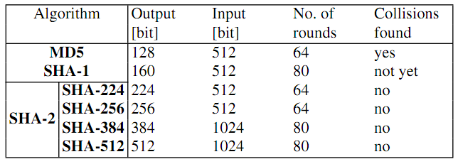
MD4 – Family of Hash Functions

Slide 4
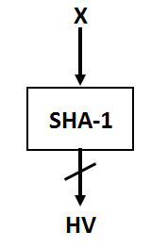
Overview of SHA-1
512 bits
Half dead algorithm
Partially broken
Merkle Damgard Construction
160 bits

Slide 5
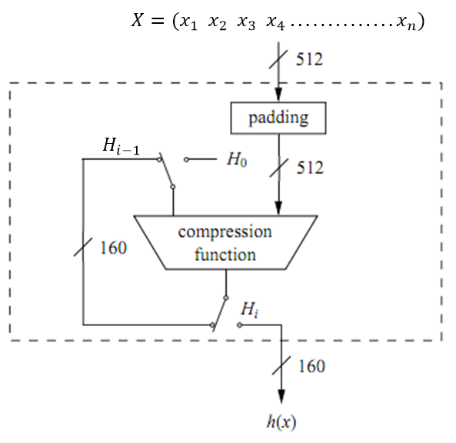
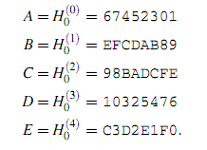
Overview of SHA-1
Merkle Damgard
Default Value of Ho
h1 = CF (x1, h0) // for x1
h2 = CF (x2, h1) // for x2
h3 = CF (x3, h2) // for x3
hn = CF (xn, hn-1) // for xn -> final output
h(x)

Slide 6
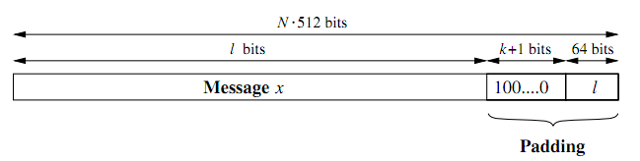
Bit Padding
Assume that we have a message x with a length of l bit. To obtain an
overall message size of a multiple of 512 bits, we append a single “1” followed
by k zero bits and the binary 64-bit representation of l. Consequently, the number
of required zeros k is given by
k ≡ 512−64−1−l
= 448−(l+1) mod 512

Slide 7
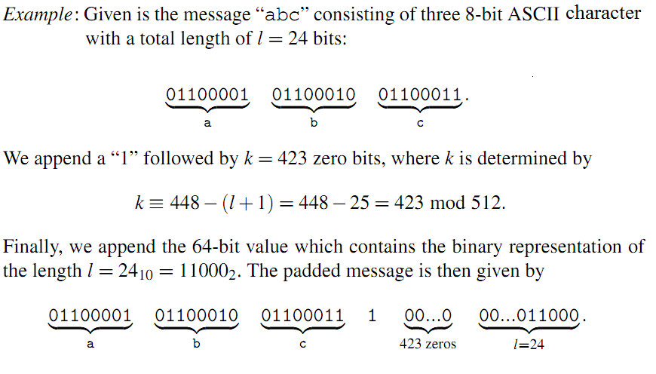

Slide 8
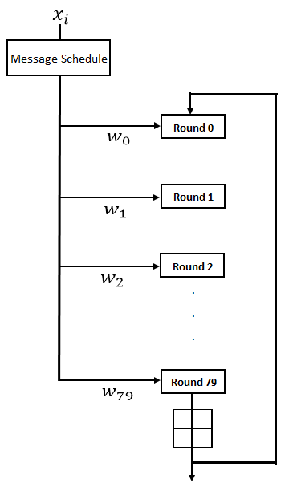
Compression Function
Consists of 4-stages and 80 rounds
Stage 1: 0-19 Rounds
Stage 2: 20-39 Rounds
Stage 3: 40-59 Rounds
Stage 4: 60-79 Rounds

Slide 9
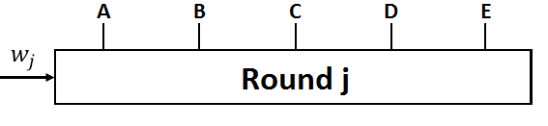
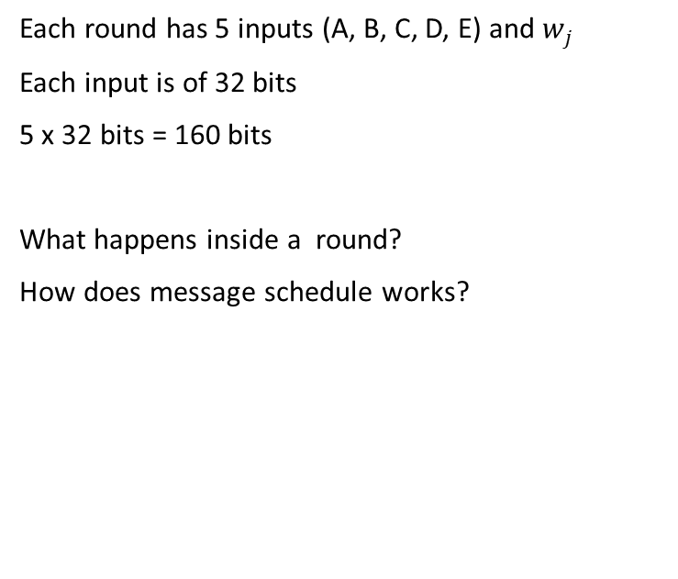
Round Function
Each round has 5 inputs (A, B, C, D, E) and $w_{j}$
Each input is of 32 bits
5 x 32 bits = 160 bits
What happens inside a round?
How does message schedule works?

Slide 10
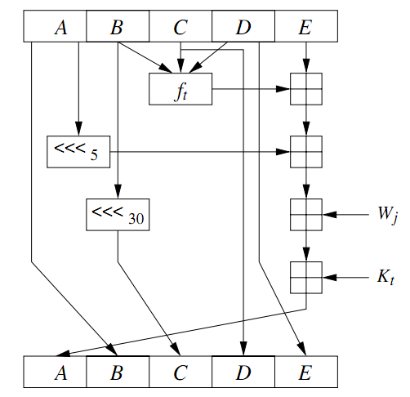
Round Function
Rj
Rj+1

Slide 11
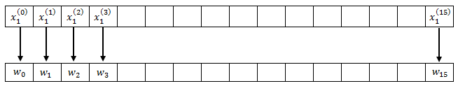
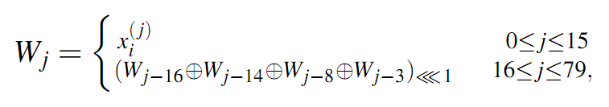
Message Schedule

Slide 12
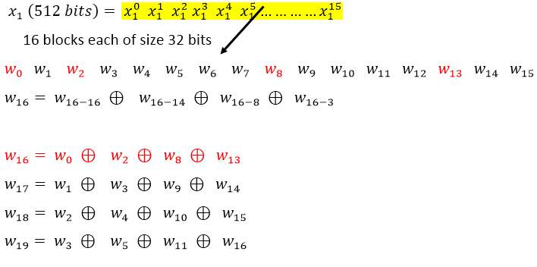
Message Schedule

Slide 13
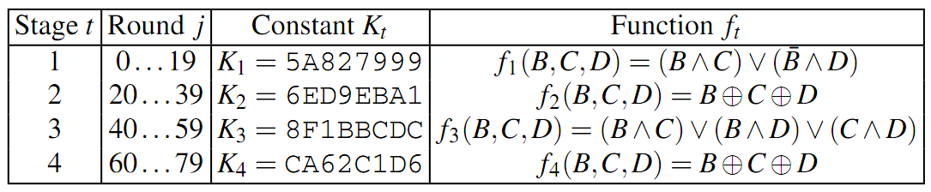
Round Constant and Function

Slide 14
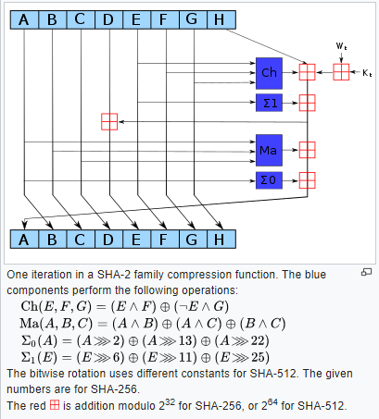
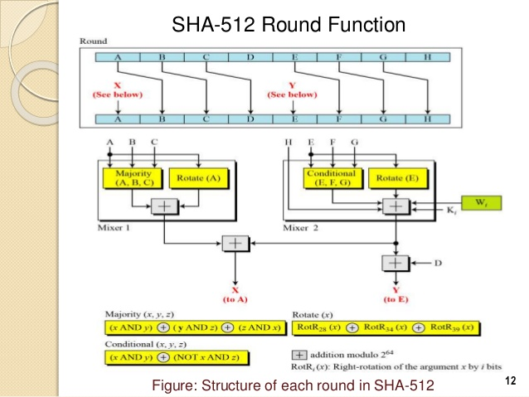
SHA-256

